Slide 1
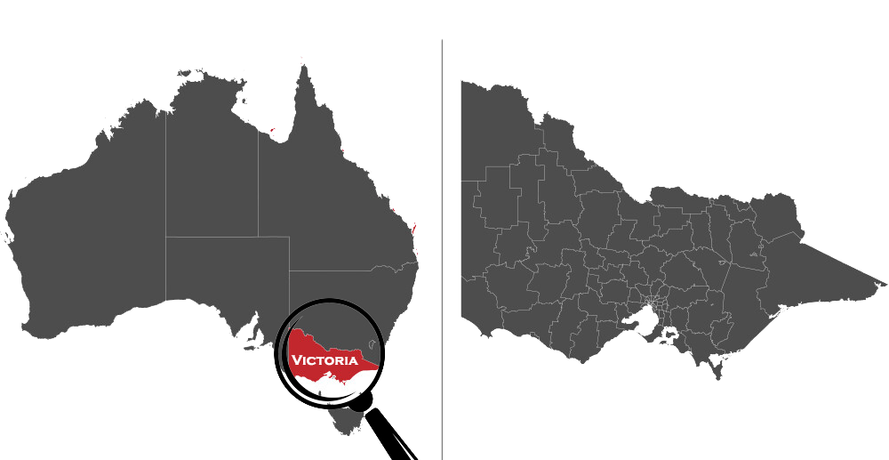
Crime Analysis in Victoria
Team 1:
Muzaffar Amin
Mahsa Hesampour
Vi Bui
Carla Llanto

Slide 2
Presentation Outline:
Research Questions
Data sources
Limitations
Data exploration and clean up process
Analysis and Visualization of Data
Conclusions and recommendations
Notes:
This project investigates crime rates in Victoria, Australia (2014 and 2023) We're analysing data on Local Government Area (LGA) crime rates per 100,000 population, along with economic indicators like unemployment and inflation rates.
Our goal is to identify patterns in crime occurrence across Victoria and explore potential links with these economic factors. By analysing these relationships, we hope to gain valuable insights that can inform crime prevention strategies and recommendations for the Victorian government and police.

Slide 3
Research Questions:
01
02
03
04
Find the distribution of crime rate by all Local Government Area(LGA)s in Victoria?
Which LGAs have the highest crime rates and how has it changed over the past 10 years?
What are the major divisions of crime in Victoria and how has it changed over the past 10 Years?
Do economic factors, such as unemployment rate and inflation rate, affect crime rates?

Slide 4

Data Sources/ Data sets used:
Crime Statistics Agency
Data Tables LGA Criminal Incidents Year Ending December 2023 (XLSX, 17.29 MB)
Australian Bureau of Statistics
Labour Force, Australia, February 2024
Consumer Price Index, Australia, December Quarter 2023

Slide 5
Limitations of the Data set:
01
02
03
Unavailability of crime statistics data for more than 10 years
No thorough breakdown of different crime statistics (such as gender, age groups)
Format of data –understanding the format of data provided
Notes:
Statistics such as age group of people committing crime and gender

Slide 6
Data exploration and clean up process:
Searching online for relevant data
Data selection based on research questions
Variable identification
Converting our Excel files to CSV formats
Data Organisation - Creating data frames for Analysis
Notes:
We were able to get couple of data sets , one from CSA and one from ABS, and then we selected the data we thought that would answer our research questions.

Slide 7
Research Question 1
Find the distribution of crime rate by all Local Government Area(LGA)s in Victoria?

Slide 8
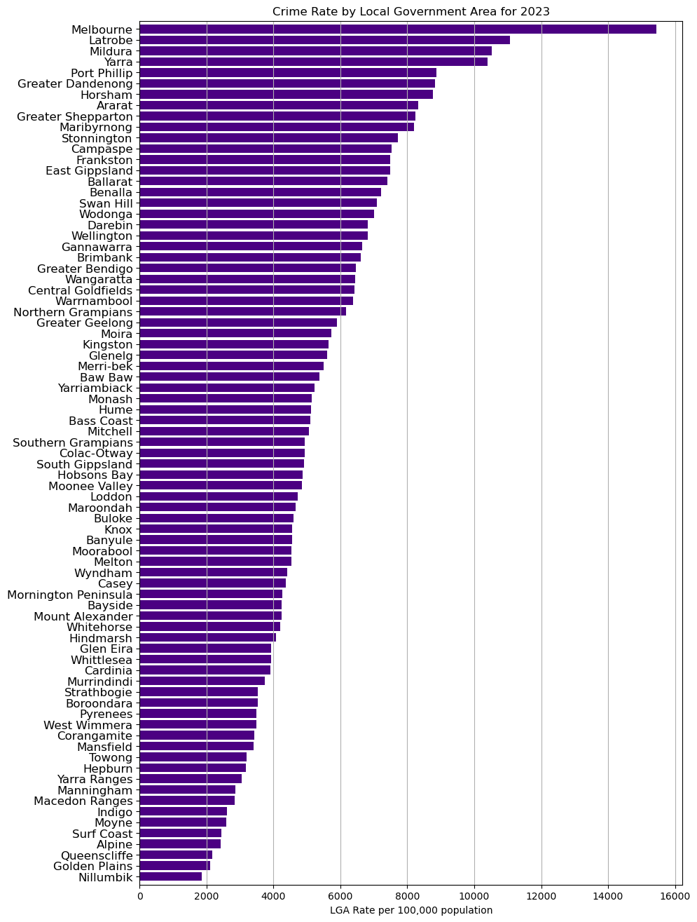

Snapshot of crime rate in Victoria in 2023
79 LGAs in Victoria
LGAs are sorted by crime rate per 100,000 population
Melbourne has the highest crime rate while Nillumbik has the least.
Notes:
This analysis provides insights into the distribution of crime rates across all LGAs in Victoria. The graph likely shows that 23% of the total crime rate is attributed to the top 10 LGAs, while the remaining 77% is distributed among the other 69 LGAs.

Slide 9
Research Question 2
Which LGAs have the highest crime rates and how has it changed over the past 10 years?

Slide 10
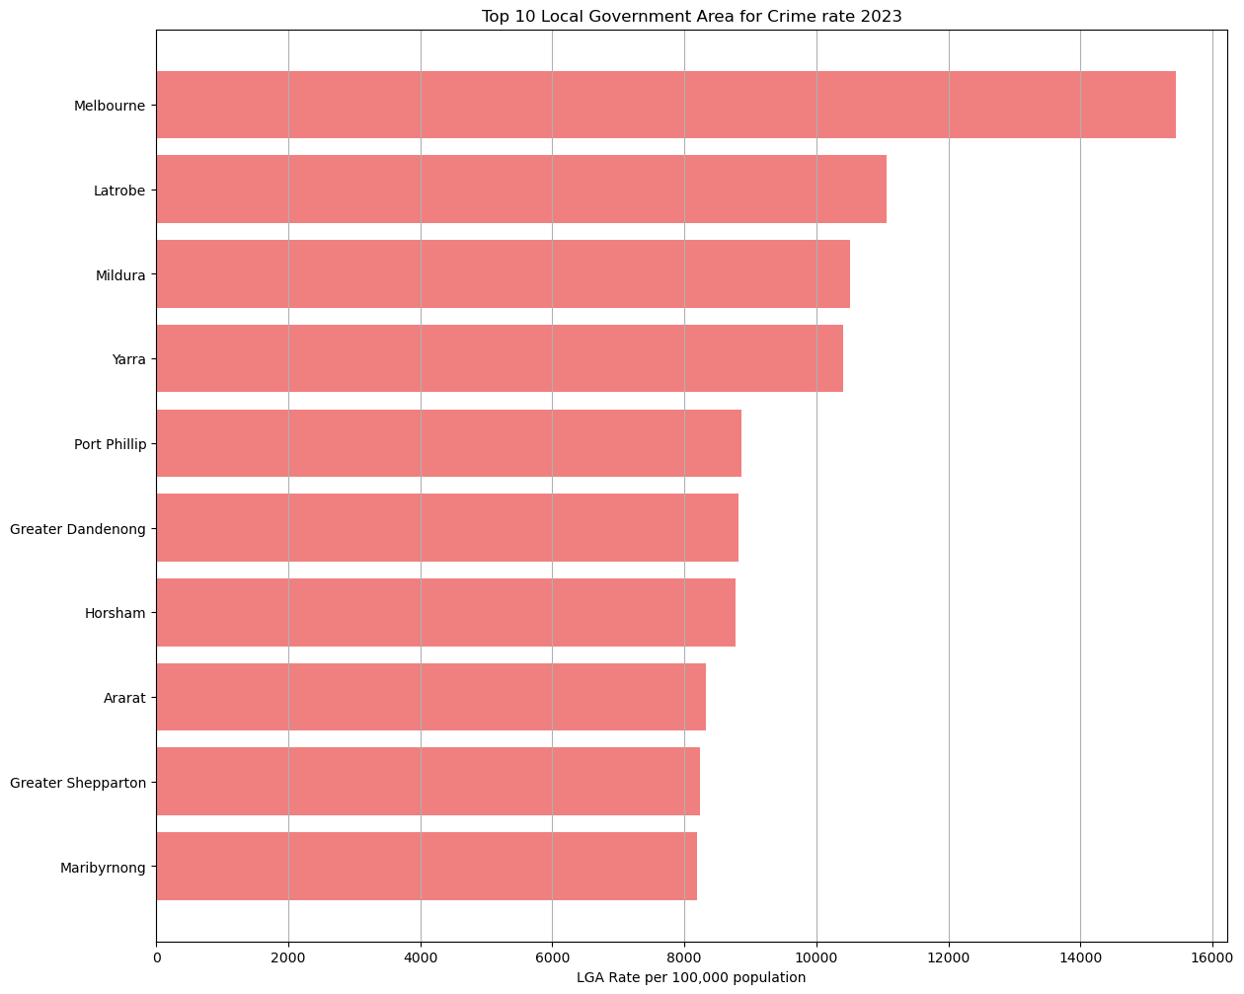
Top 10 LGA Area for crime rate 2023
Melbourne with the highest crime rate of 15,451, followed by Latrobe 11,063 and Mildura 10,514.
Mildura has the biggest LGA in terms of land area (followed by East Gippsland, which is ranked 14th). It is also on the border of two other states.
This might indicate patterns in crime rates based on urban-rural disparities.
Factor to be considered would be the number of the people who are living in the specific LGAs.
Notes:
By sorting the LGAs in descending order, the top LGAs by crime rates in 2023 per 100,000 population are: Melbourne with the highest crime rate of 15,451, followed by Latrobe at 11,063 and Mildura at 10,514.
The rest of the top 10 are as follows:
Yarra - 10,406
Port Phillip - 8,869
Greater Dandenong - 8,816
Horsham - 8,769
Ararat - 8,327
Greater Shepparton - 8,237
Maribyrnong - 8,189
Looking at the locations of the LGAs, half of the LGAs in the top 10 are closer to the Victorian capital and are considered urban (i.e., Melbourne, Yarra, Port Phillip, Greater Dandenong, Maribyrnong), while the other half are further away and are considered regional (i.e., Latrobe, Ararat, and Greater Shepparton) and rural (i.e., Mildura, and Horsham). This might indicate patterns in crime rates based on urban-rural disparities.
Another thing to note is that, while rural Mildura is ranked third overall, it is also the biggest LGA in terms of land area (followed by East Gippsland, which is ranked 14th). It is also on the border of two other states, which may play a role in the higher crime rate as compared to other rural areas.
Considering that most of the population in Victoria is centered towards the urban areas, another factor to be considered would be the number of the people who are living in the specific LGAs. It is to be noted that as we move towards the rural or regional Victoria, the population per square kilometer lessens. Hence, this may attribute to lesser crime rates in those areas.

Slide 11
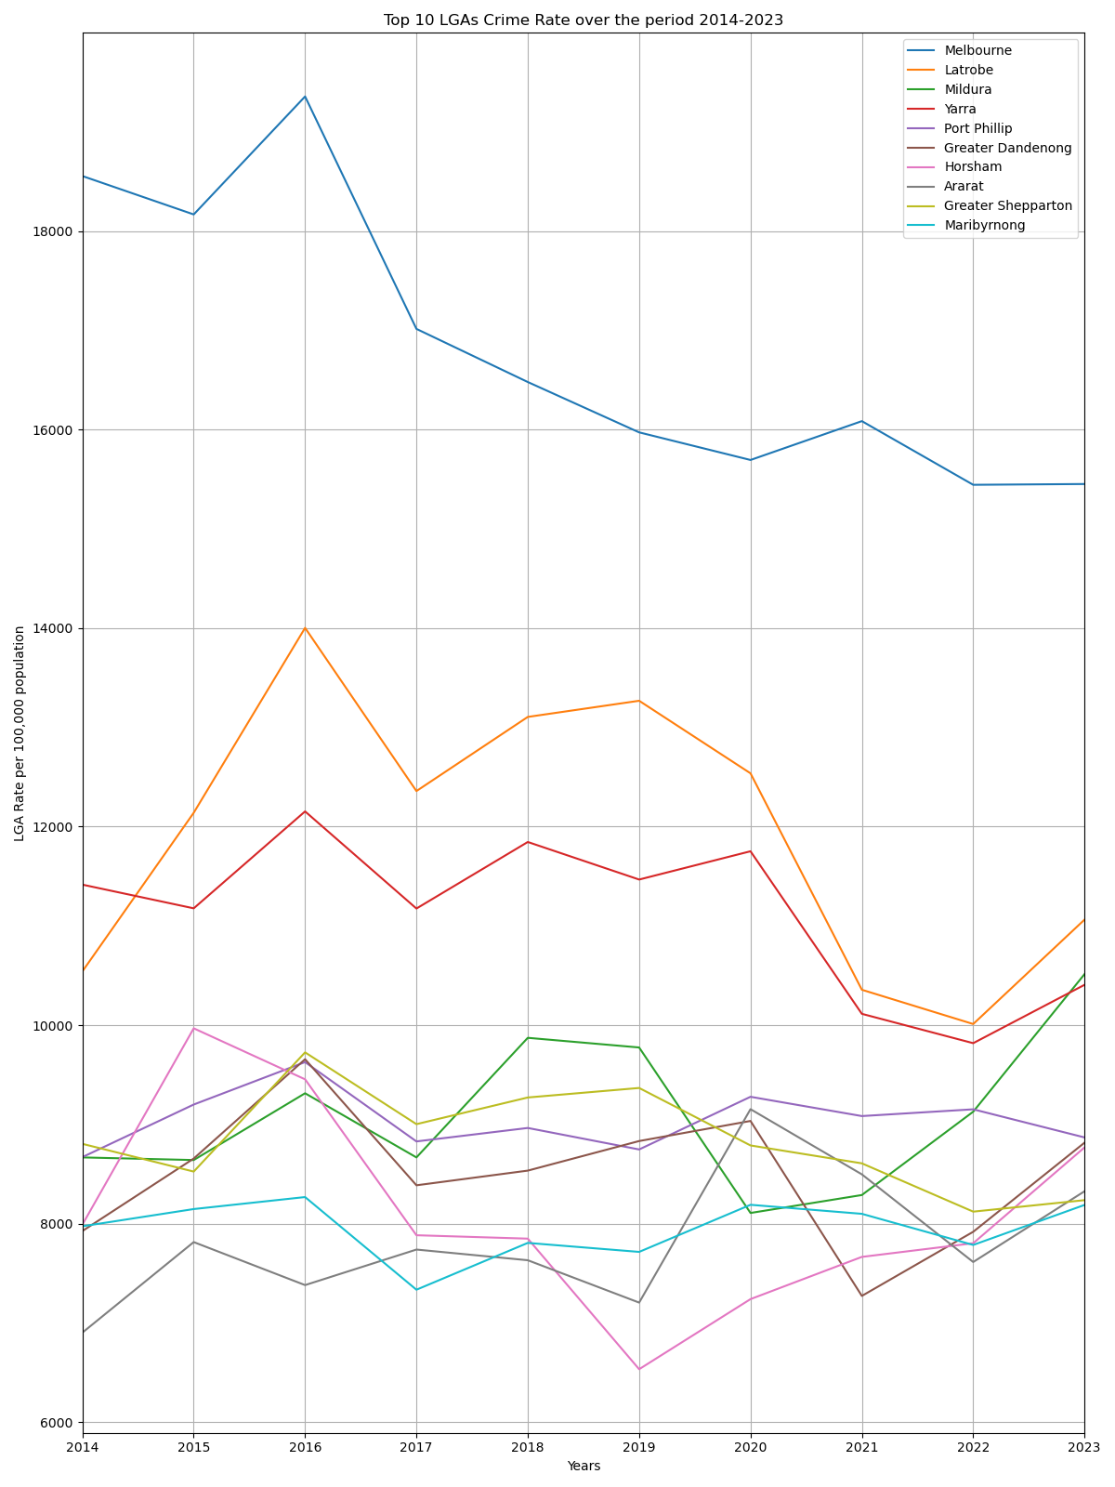
Top 10 Crime Rates over the period of 2014-2023
This analysis provides insights into the trends and fluctuations in crime rates across the top 10 LGAs in Victoria over the years.
In 2016, an increase to crime rates was observed in most of the top 10 LGAs, except for Horsham and Ararat.
In 2022, 60% in the top 10 LGAs have drop-in crime rate with Melbourne, La Trobe, Yarra and Greater Shepparton reaching its lowest crime rate within the period covered.
Overall crime rates of Melbourne decreased approximately by 16% over the years 2014 to 2023.
Notes:
This analysis provides insights into the trends and fluctuations in crime rates across the top 10 LGAs in Victoria over the years.
Looking at Graph 3, it is visible that the overall crime rates of Melbourne decreased over the years 2014 to 2023. Considering the start and end period, the crime rate has decreased by approximately 16%.
For Latrobe and Yarra, there was an increase in 2016, and between 2018 and 2020, before decreasing back to around the same rate as in 2014. From the duration of the period covered, it is noticeable that La Trobe had frequent spikes in terms of upstreams and downstreams while Yarra, on the other hand did not have very steep changes year on year.
Tracking Horsham, there was a dip in crime rates in 2019 but it has started to increase again in recent years. Otherwise, for the other LGAs, there seems to be a slight increase from 2014 to 2023.
In 2016, an increase to crime rates was observed in all of the top 10 LGAs, except for Horsham and Ararat. More information will need to be researched to understand why there was an increase specifically in 2016.
In 2022, 60% in the top 10 LGAs have drop-in crime rate with Melbourne, La Trobe, Yarra and Greater Shepparton reaching its lowest crime rate within the period covered.
Overall, Melbourne had the highest crime rate throughout this period, followed by Latrobe and Yarra. On the other hand, the remaining LGAs swap positions, while remaining in the top 10. Furthermore, there is also a possibility that a couple of LGAs drop out of the top 10 in some years due to decrease in crime rates.

Slide 12
Research Question 3
What are the major divisions of crime in Victoria and how has it changed over the past 10 Years?

Slide 13
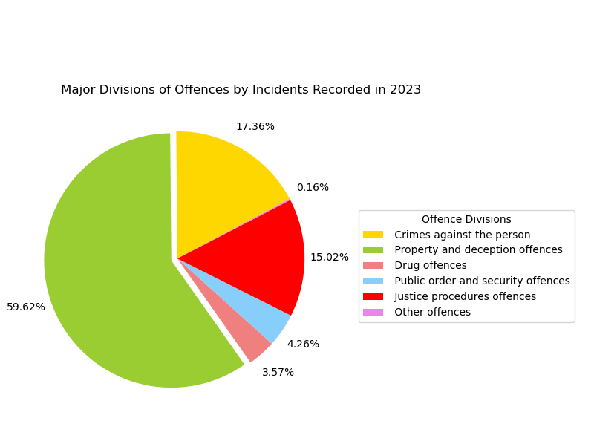
Snapshot of major divisions of crime
Highest proportion of the incidents recorded is 'property and deception offences’
Major division of offences are further sub-divided into various minor offences. With most of the common crimes fall under ‘Property and deception offences’.
Notes:
Analysing Graph 4 will find that the offence division with the highest proportion of the incidents recorded is 'property and deception offences'. This division includes offences such as:
Burglary
Theft (including vehicle theft)
Forgery
Graffiti
Deception/false information
Property damage (including arson)
However, a good reminder is the fact that 'property and deception offences' is a category that consists of many common crimes, whereas divisions like 'drug offences' and 'public order and security offences' are more specific. For example, 'drug offences' includes the possession, use, manufacturing, and trafficking of drugs, while 'public order and security offences' includes offences such as possession of firearms and explosives, offences relating to riots, and offensive behaviours and conduct.
Another point of interest that is worth investigating is the fact that the offences in 'property and deception offences' are relatively easier to get evidence for and record as opposed to crimes relating to drugs or crimes against the person, where more in-depth investigations are usually carried out.
For 'justice procedures offences' division, the offences that it covers partially involves people who have already commited other offences, so the population of people who would be able to be charged for these offences are relatively low. Such offences includes: escape custody, offences relating to prison regulation, breaching orders and bail conditions, as well as resist or hinder officers.
Meanwhile, the 'other offences' division only includes crimes that could not be categorised into the other divisions, making this category somewhat negligible in the analysis of what crime divisions have the highest incidents recorded.
With all the factors and considerations mentioned above, it would be notable that the Major division of offences are further sub-divided into various minor offences. Considering that most of common crimes that frequently occur fall under the "Property and deception offences" umbrella, It is not surprising that the percentage of the crimes under this division sums up to be bigger that all the other divisions combined.
Overall, this breakdown provides insight into the types of offences that contribute to the overall crime rate and highlights the varying specificity and difficulty of detection for different types of crimes.

Slide 14
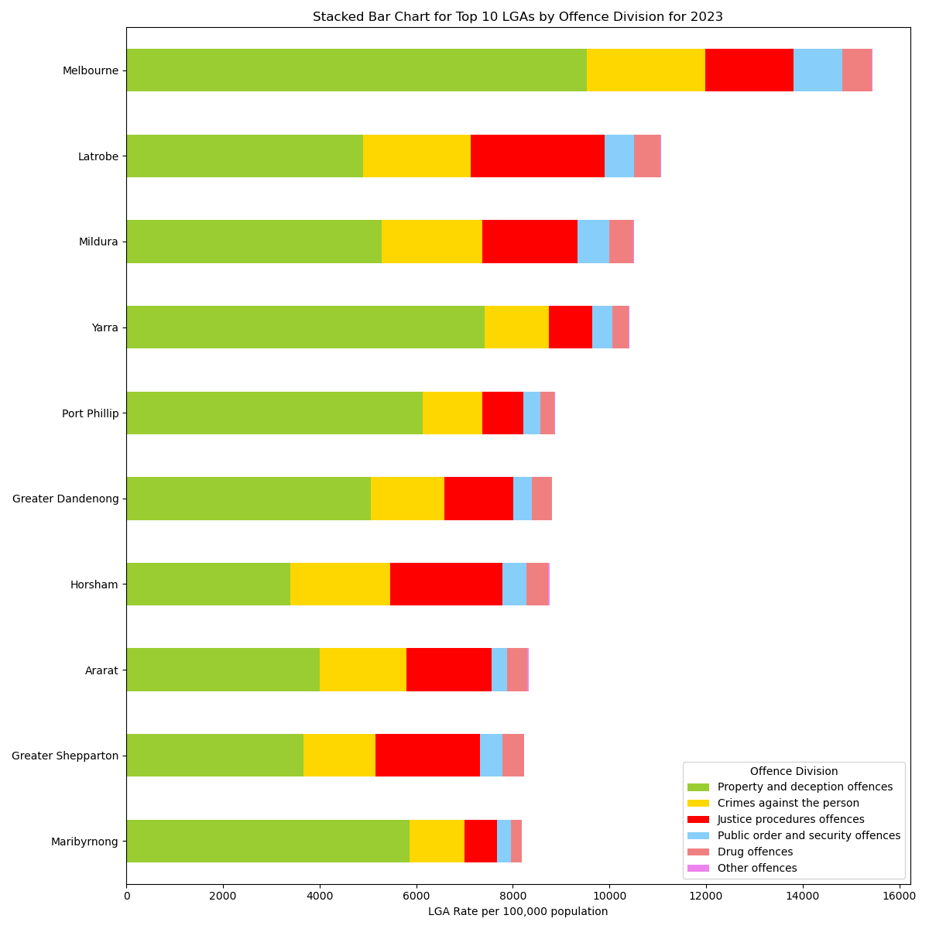
Top 10 LGAs by Offence Division
'Property and deception offences' takes up more than 50% of most of the LGAs' total incidents
Holtham has highest percentage with 23.63% for Crimes against the person, while Melbourne only has 15.80%
Notes:
Looking at Graph 5, it can be observed that 'property and deception offences' takes up more than 50% of most of the LGAs' total incidents. However, there are some LGAs where the distribution of offence divisions is more equal. For example, Horsham has the least number of 'property and deception offences', but the higher numbers of offences in the other division (namely 'justice procedure offences' and 'crimes against the person') places it at 7th, above Maribyrnong, that has more incidents recorded in the 'property and deception offences' division.
Furthermore, Yarra has the second most 'property and deception offences' but only ranks 4th because of the smaller amount of crimes committed in the other divisions. This is also the same with Maribyrnong having the third highest 'property and deception offences' but only ranking 10th overall.
In terms of Crimes against the person, of top 10 LGA's with the highest crime rates, Holtham has highest percentage with 23.63% followed by Ararat at 21.60%. Meanwhile, though Melbourne has the highest crime rate across the LGA's, only 15.80% of all its offences are crimes against the person and only 6.53% of those are crimes against public order and security offences.

Slide 15
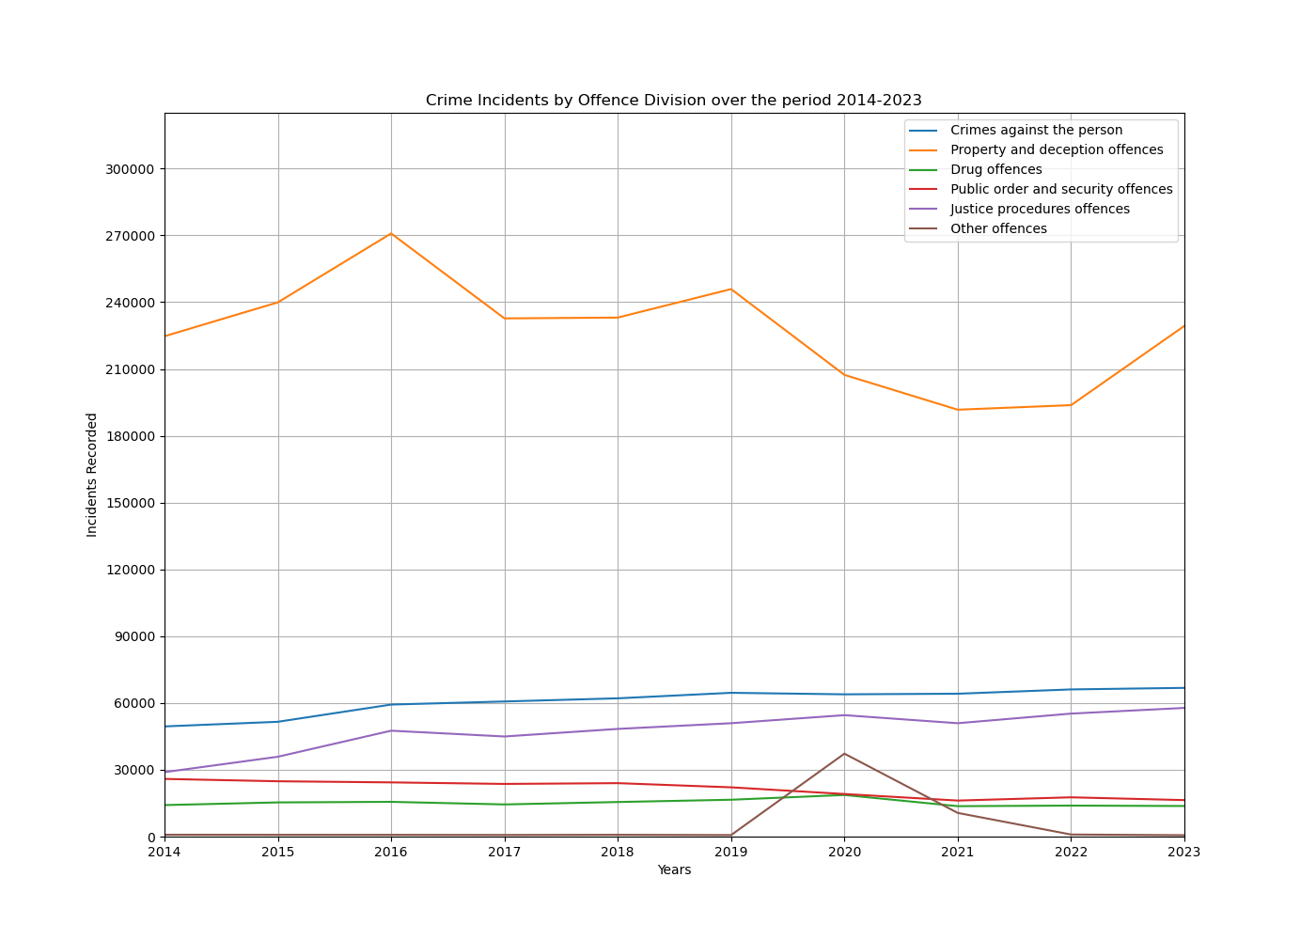
Crime Incident Rate by Offence Division over the period
Spike of 'other offences' in 2020 and a drop-in 'property and deception offences’
The sudden change may be attributed to the lockdowns that happened in Victoria during COVID-19
Other divisions have a steady number of incidents over the years and could suggest that certain types of crimes are less influenced by external factors like lockdowns and may have more consistent underlying causes or dynamics.
Notes:
Regarding graph 6, there appears to be to a spike of 'other offences' in 2020. Additionally, there was also a drop in 'property and deception offences' during that year. These sudden increase and decrease (respectively) of the two divisions may be attributed to the lockdowns that happened in Victoria during that time period as a result of COVID-19. It could explain why there was a drop in 'property and deception offences' as most people would be inside their homes and offences against property would be reduced. However, more research will need to be conducted for these time periods to solidify the correlation between COVID-19 and the decrease of 'property and deception offences'. It might involve comparing crime data from Victoria with other regions that experienced different lockdown measures or analyzing additional factors such as economic conditions or policing strategies during the lockdown period.
On the other hand, the other offence divisions seem to have a steady amount of incidents over the years. It could suggest that certain types of crimes are less influenced by external factors like lockdowns and may have more consistent underlying causes or dynamics.

Slide 16
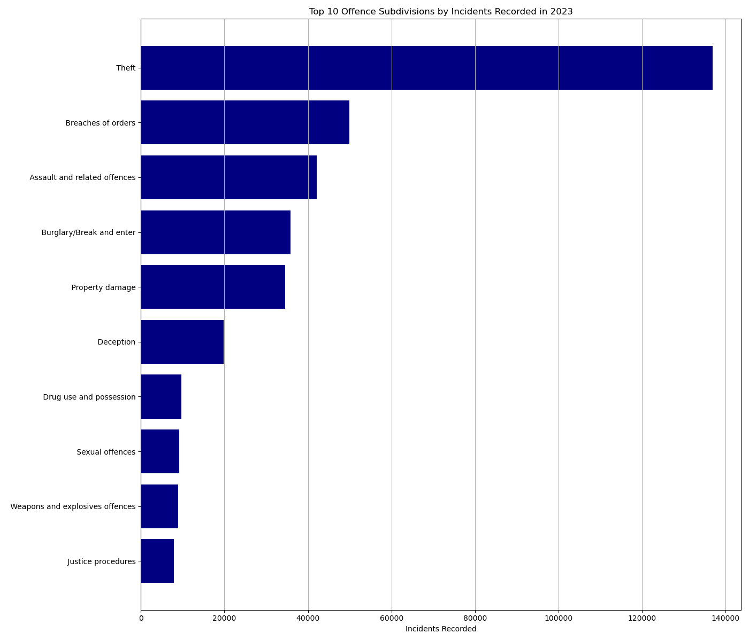
Top 10 Offence Subdivisions by Incidents Recorded in 2023
Highest number of recorded incidents is Theft
Factors such as economic conditions, opportunity, and individual motivations can all contribute to the prevalence of theft.
Notes:
This analysis demonstrates a thoughtful approach to interpreting crime data and highlights the complexity of understanding crime patterns.
The offence subdivision that has the highest number of recorded incidents is theft, which is under the 'property and deception offences' division. More research will be needed to understand why theft has the highest number of incidents recorded. However, an inference can be made that theft is a relatively easy offence to commit. Factors such as economic conditions, opportunity, and individual motivations can all contribute to the prevalence of theft. At the same time, theft often leaves tangible evidence and may be more straightforward for law enforcement to investigate and prosecute compared to complex crimes involving drugs or organized groups.
Offences that are more specific (i.e., firearms and drugs) have lower incident numbers as the categories does not cover a large variety of offences. It is also possible that those categories have low numbers because it takes a lot of time and effort to investigate those offences, especially if it involves groups of people.

Slide 17
Research Question 4
Do economic factors, such as unemployment rate and inflation rate, affect crime rates?

Slide 18
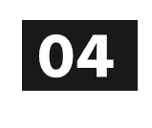

Research Question
Do economic factors ‘unemployment rate’ and ‘inflation rate’, affect crime rates?

Slide 19

Hypotheses
Null hypothesis (H₀):
The rate of unemployment and inflation does not influence crime rates in Victoria.
Alternative Hypothesis (H_{a}):
The rate of unemployment and inflation does influence crime rates in Victoria.

Slide 20
Multiple Regression Analysis
Multiple regression function:
Crime rate = f (economic indicators)
Crime rate = f (average unemployment rate, average inflation rate of Consumer Price Indexes)
Multiple regression equation:
Y= E_{o} + E₁X_{u} + E₂X_{i} + ε
Y= Crime rate (dependent variable)
E_{o}= Intercept of the regression
E_{1,} E₂ ₌ calculated coefficients from the regression
X_{u =} average unemployment rate (independent variable)
X_{i =} average inflation rate (independent variable)
ε = error term of the regression
Notes:
Based on past 10 years of data

Slide 21
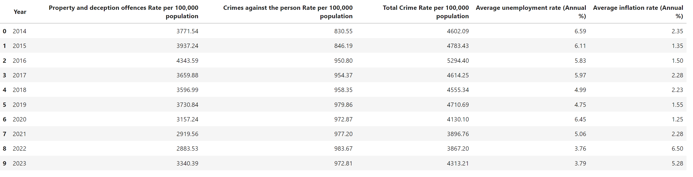
Dataset for Regression Analysis
Y= E_{o} + E₁X_{u} + E₂X_{i} + ε
Three equations for 3 different regression summaries:
Y (Crime against the person rate) = E₁X_{u} + E₂X_{i} + ε
Y (Property and deception offences rate) = E₁X_{u} + E₂X_{i} + ε
Y (Total crime rate) = E₁X_{u} + E₂X_{i} + ε

Slide 22
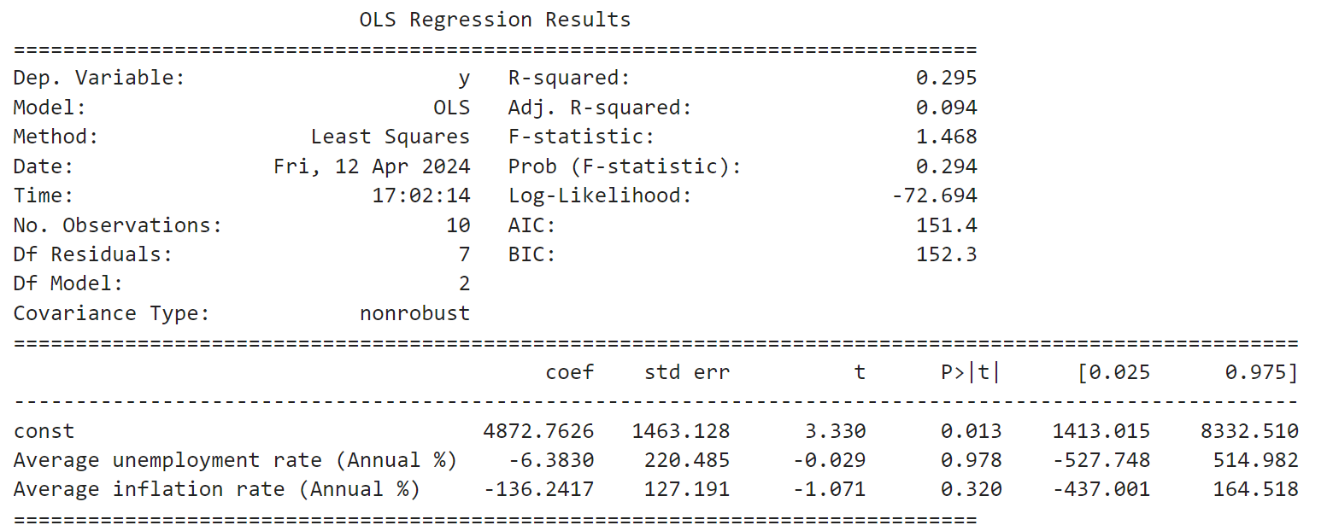
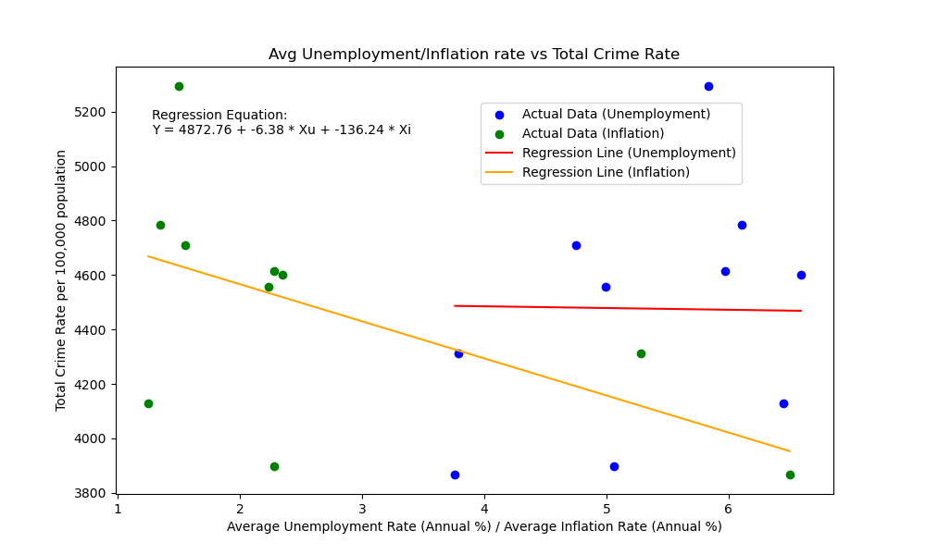
Dependent Variable: Total Crime Rate
Regression output results from Jupyter notebook:
Testing at alpha level =0.05
Inferences:
R-squared (R²) of 0.295 indicates 29.5% of the variance in the dependent variable is explained by the independent variables .
The F-statistic tests the overall significance of the model.
With a p-value of 0.294, the model as a whole is not statistically significant.
The independent variables does not effectively explain the variation in the Total Crime Rate per 100,000 population.

Slide 23
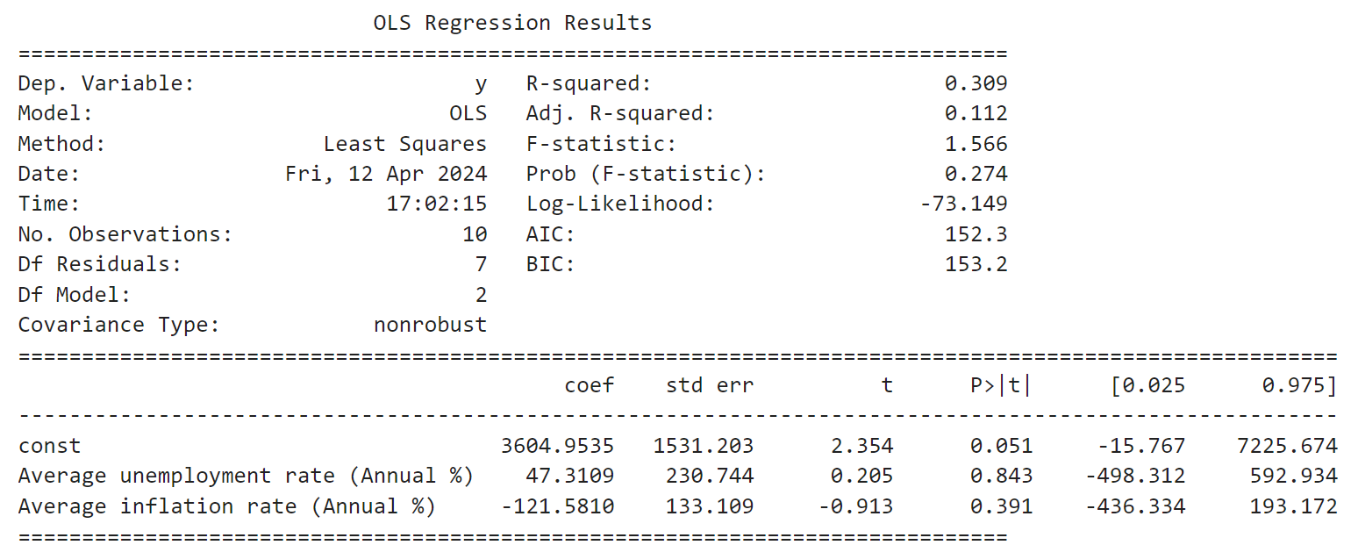
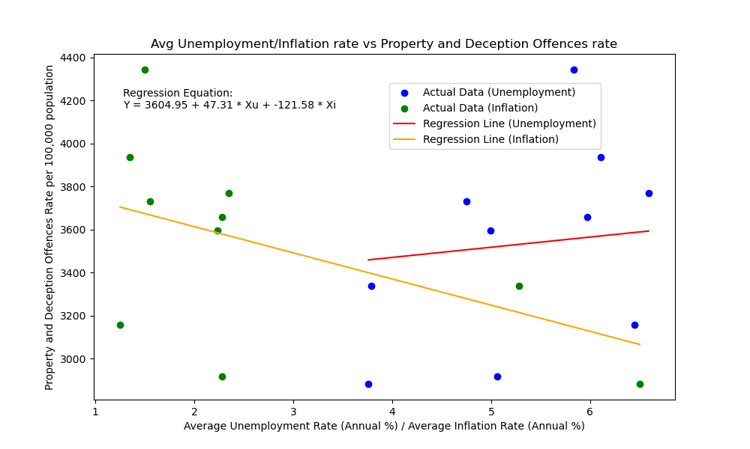
Dependent Variable: Property and deception offences rate
Regression output results from Jupyter notebook:
Testing at alpha level =0.05
Inferences:
R-squared (R²) of 0.309 indicates that approximately 30.9% of the variance in the dependent variable is explained by the independent variables.
With a F-statistics p-value of 0.274, the model as a whole is not statistically significant.
Independent variables, as a group, do not reliably predict the dependent variable.
The independent variables does not effectively explain the variation in the Property and deception offences Rate per 100,000 population.

Slide 24
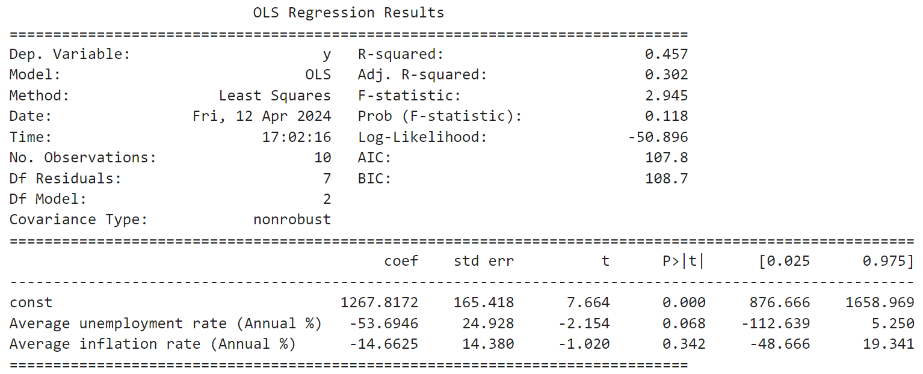
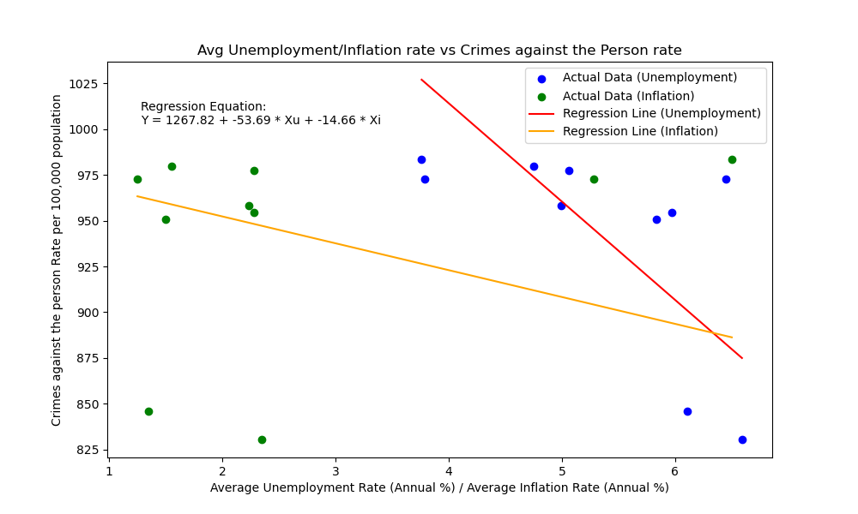
Dependent Variable: Crime against the person rate
Regression output results from Jupyter notebook:
Testing at alpha level =0.05
Inferences:
R-squared (R²) of 0.457 indicates that approximately 45.7% of the variance in the dependent variable is explained by the independent variables.
With a F-statistics p-value of 0.118, the model as a whole is not statistically significant in predicting Crimes against the person Rate per 100,000 population.

Slide 25
Conclusions/Recommendations

Slide 26
Conclusions:
Melbourne has the highest crime rate.
Urban and regional areas both have high crime rates.
Property crimes are most common.
COVID-19 lockdowns might have impacted crime rates.
Theft is the most frequent offence.
Fail to reject the null hypothesis: The rate of unemployment and inflation does not influence crime rates in Victoria.
All 3 regression models did not show statistical significance in predicting crime rates in Victoria.
Other factors (such as psychological, social, political, and self interest) may be what’s driving crime in Victoria than economic factors.

Slide 27
Recomendations:
Focus on High Crime Rate LGAs
Addressing Potential Socioeconomic Factors
Community Engagement and Crime Prevention
Focus on Rehabilitation and Reintegration
Invest in Data-Driven Policing
Exploring additional economic variables such as change in RBA interest rate and real GDP over the years.
Gaining access to a larger historic dataset for a more robust analysis

Slide 28
Thanks!
Do you have any questions?

